Slide 1
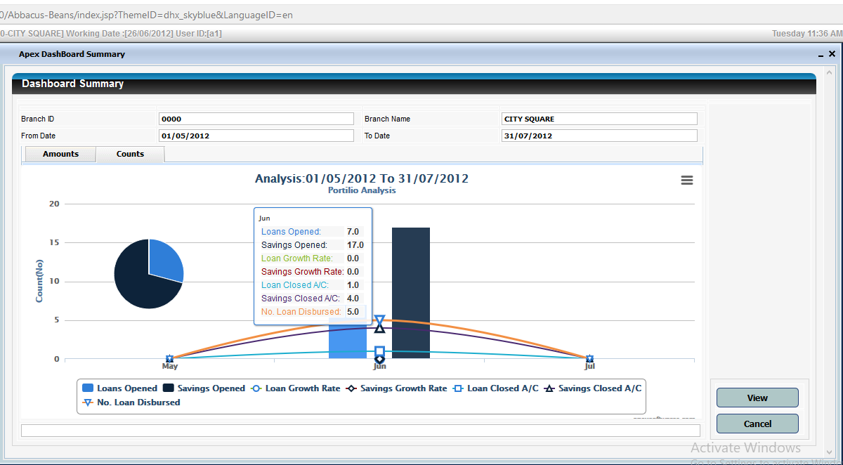
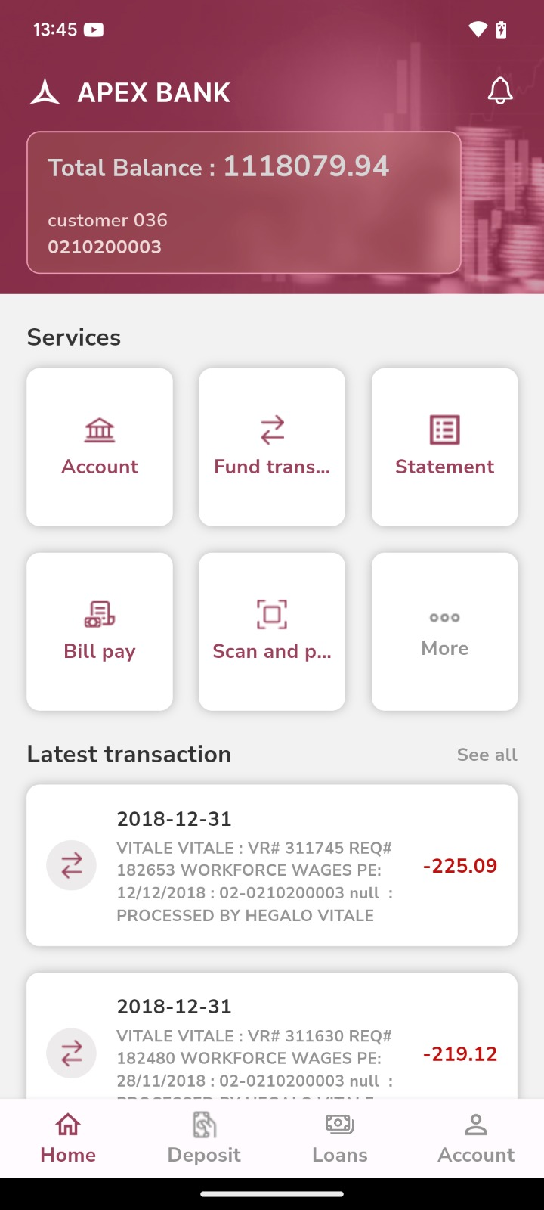
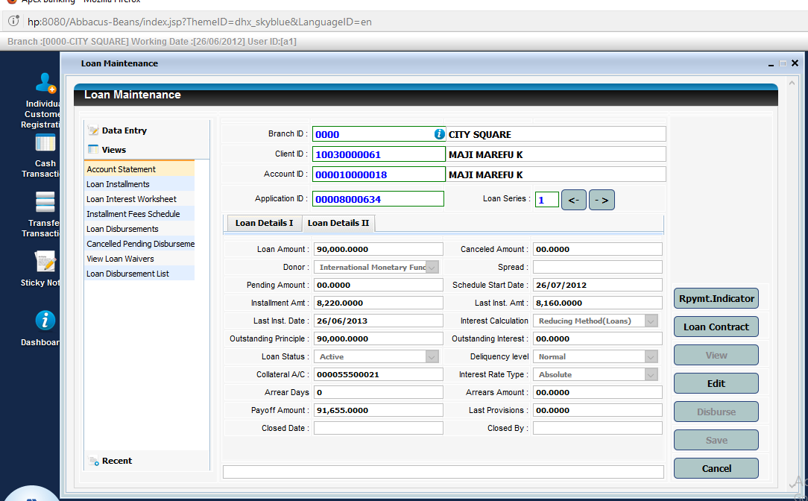
EXECUTIVE EDITION
Apex Core Banking for Ethiopian Microfinance Leaders
A modern core designed to strengthen control, scale inclusive outreach, and accelerate digital service delivery across branches, field teams, and customer channels.
Multi-branch control
Loans + savings + group lending
Mobile/USSD + API
BI + audit trail
Ethiopian MFI CEO conversations
Product capabilities sourced from the existing Apex deck; Ethiopia market framing updated for an executive audience.

Slide 2
ETHIOPIA MARKET MOMENT
Opportunity is expanding. So is operating complexity.
Digital growth, inclusion gaps, and infrastructure reform are all advancing at once.
54
ETB 18.5tn+
139.5m
NBE-regulated MFIs
digital transaction value in the latest NBE review period
mobile money accounts reported for 2025
Why this matters in the boardroom
80% rural
90m
The next phase of competition will not be won by branch count alone. It will be won by institutions that can combine outreach, credit discipline, digital channels, and trusted execution at scale.
share of the unbanked population living in rural areas
people targeted for access to inclusive digital ID services
Sources: NBE home page and Financial Stability Report (March 2026); NBE Draft National Digital Payments Strategy 2026-2030; World Bank Digital ID for Inclusion and Services Project (Dec. 2023); World Bank and NBE conference publication on financial inclusion barriers in Ethiopia (2024).

Slide 3
CEO PRIORITIES
The challenge is not growth alone. It is controlled, profitable, inclusive growth.
Outreach Gap
Agricultural Finance Gap
Funding + Activation Pressure
Trust + Change Pressure
More than 80% of the unbanked population is rural. Formal account ownership is only 10% for rural women and 26% for rural men.
Agriculture contributes 32% of GDP and 64% of employment, yet it has historically received less than 10% of national credit.
NAFIR says agri-finance demand far exceeds supply; NDPS 2.0 says only 15% of accounts and 25% of agents are active.
Rising fraud and security threats, Fayda rollout, and interoperability raise the bar for controls and integration.
Board-level implication
The CEOs that win this market will not just digitize faster. They will digitize with stronger controls, better data, and a lower cost-to-serve.
Sources: NBE Draft National Digital Payments Strategy 2026-2030; NBE and Ministry of Agriculture, National Agricultural Finance Implementation Roadmap 2025-2030 (July 2025); World Bank financial inclusion barriers publication (2024); World Bank Digital ID for Inclusion and Services Project (Dec. 2023).

Slide 4
THE APEX RESPONSE
Apex addresses the issues CEOs care about most
Growth with Discipline
Control Across Branches
Management Visibility
Digital Readiness
Manage savings, current accounts, term deposits, loans, and group lending in one integrated core.
Multi-branch support, maker-checker, role-based access, workflow controls, and audit trail reduce operational leakage.
Integrated general ledger, BI, and reporting support branch, product, and portfolio-level oversight.
Secure APIs, mobile and USSD capabilities, and cloud-ready architecture support channel and partner expansion.
Executive message
Apex turns fragmented operations into a connected control environment that is easier to scale, easier to monitor, and easier to modernize.

Slide 5
OPERATING MODEL FIT
Designed for the microfinance business model
Customer and Onboarding
Deposits and Lending
Finance and Reporting
360 customer view, document and image management, and workflow-driven servicing.
Savings, current, term deposits, loans, and group lending in one core.
Integrated general ledger, BI, and report generation for management visibility.
Governance and Control
Enterprise Support
Ecosystem Integration
Maker-checker, role-based access, audit trail, and secure approvals.
Fixed assets, procurement, inventory, and shares and dividends support.
Secure web-service API for external platforms and partner connectivity.

Slide 6
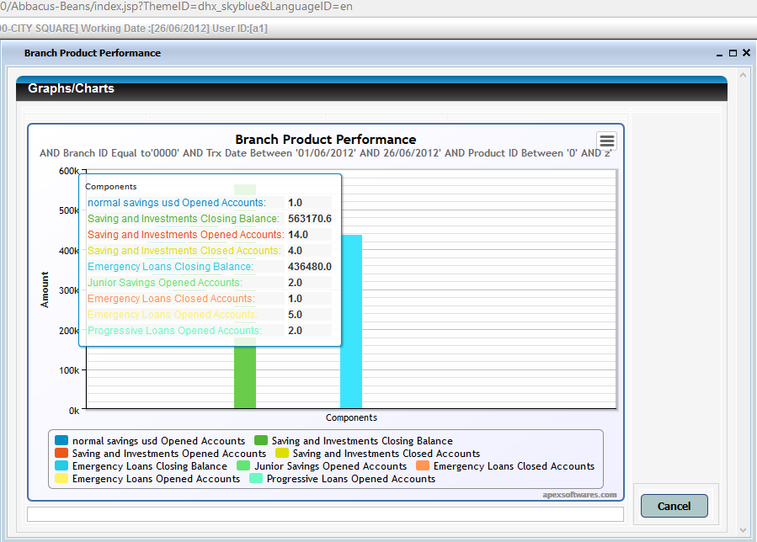
LENDING AND SERVICING
Reduce turnaround time without weakening portfolio control
What the platform enables
- Individual and group lending workflows in one platform
- Configurable approvals and user-defined workflow management
- Loan applications, statements, repayments, and disbursements
- Attached customer documents and full relationship history
- Branch and head-office reporting for faster intervention
Why this matters in Ethiopia
Where loanable funds are constrained, every approval cycle, disbursement delay, and data gap has a direct cost.

Slide 7
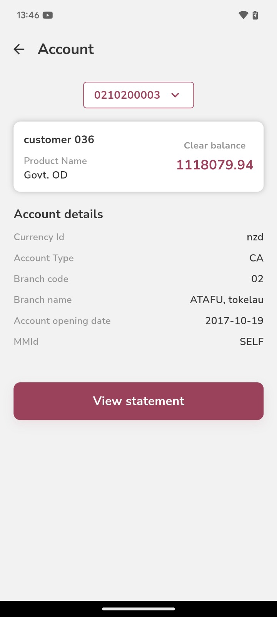
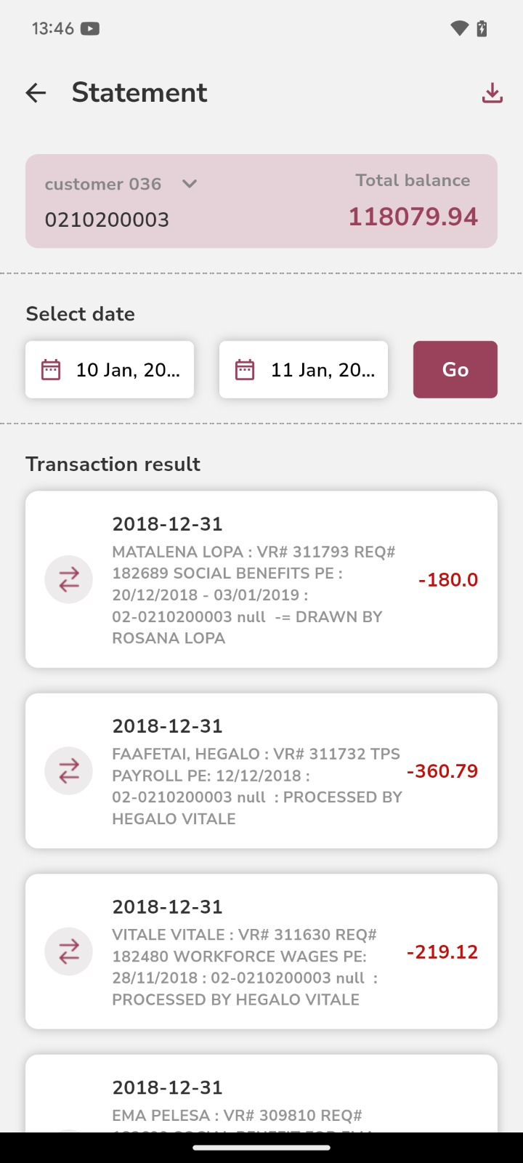
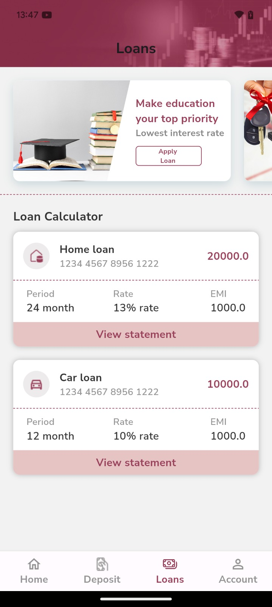
DIGITAL CHANNELS
Reach clients in branch, in the field, and on the phone
Mobile and USSD Self-Service
Balance inquiry, mini statements, transfers, wallet transactions, product information, and PIN change.
Digital Credit Servicing
Loan applications, statements, repayments, and disbursements across mobile-led customer journeys.
API-Ready Ecosystem Integration
A secure API layer provides a practical base for connections to payment rails, wallet partners, digital ID, merchants, and ecosystem platforms as local project scope requires.
Context references: NBE Draft National Digital Payments Strategy 2026-2030; GSMA and FSD Ethiopia, Mobile Money in Ethiopia: Advancing Financial Inclusion and Driving Growth (2024); World Bank Digital ID for Inclusion and Services Project (Dec. 2023).

Slide 8
CONTROL AND REPORTING
Give the CEO, CFO, COO, and Risk team one version of the truth
360 Customer Visibility
Integrated General Ledger
BI and Report Generation
Security and Audit Trail
Workflow and Document Controls
Branch-to-Head-Office Consistency
Faster board reporting, better exception management, and stronger audit confidence.
Executive outcome

Slide 9
TECHNOLOGY AND DELIVERY
Modern enough to scale, practical enough to deploy
Architecture fit
Phase 1: Core
Phase 2: Controls
Phase 3: Growth
- Service-oriented architecture
- Cloud-ready deployment model
- Browser-based client access
- Support for Microsoft and Linux/Unix servers
- Choice of MS SQL, MySQL, Oracle, or PostgreSQL
- Low total cost of ownership with scalable transaction handling
Customer, deposits, lending, GL, security, and branch controls.
Workflow, document management, BI, audit trail, and management reporting.
Mobile and USSD rollout, API integrations, and partner-led digital channels.

Slide 10
REFERENCE PROFILE
Evidence of regional relevance
The current Apex deck positions the platform across MFIs, Saccos, development banks, and agency-finance models.
Fincredit Ltd
ELCT SACCOS
Bonafide Finance Bank
Tokelau Development Bank
Kenya, Uganda, Liberia
Tanzania
Equatorial Guinea
Tokelau / New Zealand / Apia
Regional MFI operations powered by Apex across multiple countries.
Seven branches and a customer base of 15,000+ in the current deck.
Cloud-based deployment supporting a network of 300+ agents.
Development bank operations featured in the base presentation.
Regional proof points above are drawn from the original Apex deck.

Slide 11
EXECUTIVE OUTCOME
What Apex can help an Ethiopian MFI leadership team achieve
Stronger Operational Discipline
Faster Product and Branch Execution
Reduce manual leakage through workflow, maker-checker, and audit controls.
Standardize processes while giving branches and teams the tools to move faster.
Better Capital Allocation Visibility
A Stronger Base for Digital Expansion
See performance by branch, product, and portfolio before problems become expensive.
Support mobile, USSD, and ecosystem integration from a single operating core.
Run a fit-gap and workflow design session focused on products, approvals, reports, channels, and integration priorities for the Ethiopian market.
Recommended next step

Slide 12
REFERENCES
Ethiopia market context used in this revamp
Market references behind the Ethiopia-specific reframing.
Source set
- National Bank of Ethiopia home page and sector overview, accessed April 1, 2026
- National Bank of Ethiopia, Draft National Digital Payments Strategy 2026-2030
- National Bank of Ethiopia, Financial Stability Report, March 2026
- National Bank of Ethiopia and Ministry of Agriculture, National Agricultural Finance Implementation Roadmap 2025-2030, July 2025
- World Bank, Digital ID for Inclusion and Services Project, December 13, 2023
- World Bank and National Bank of Ethiopia conference publication on barriers to financial inclusion in Ethiopia, 2024
- GSMA and FSD Ethiopia, Mobile Money in Ethiopia: Advancing Financial Inclusion and Driving Growth, 2024

